Slide 1

West Midlands Key Health Data 2011/12
Launch Event
Monday 18 March 2013
12.30pm – 3.30pm
Michael Tippett Room, Staff House
University of Birmingham
Chapter 7 Measuring inequalities in small area life expectancy
Chapter contributions from:
West Midlands Cancer Intelligence Unit
Health Protection Agency West Midlands
The Perinatal Institute
NHS Warwickshire
Warwickshire County Council
Staffordshire County Council / NHS Staffordshire and NHS Stoke-on-Trent
Heart of England Foundation Trust
West Midlands Commissioning Support Unit

Slide 2
West Midlands Key Health Data 2011/12
Measuring inequalities
in small area life expectancy
Chapter 7 Measuring inequalities in small area life expectancy
Daniel Eayres, Jane Fletcher, WMCSU
Paul Kingswell, NHS Warwickshire

Slide 3
Why measure life expectancy?
Longstanding and widely used measure of overall health outcome
Quantifies mortality risks in a readily understandable metric
Used in previous PSA target to reduce health inequalities between LAs
Public Health Outcomes Framework – Overarching outcomes
  increased healthy life expectancy, i.e. taking account of the health quality as well as the length of life;
  reduced differences in life expectancy and healthy life expectancy between communities (through greater improvements in more disadvantaged communities).
West Midlands Key Health Data 2011/12
Chapter 7 Measuring inequalities in small area life expectancy
Daniel Eayres, Jane Fletcher, WMCSU; Paul Kingswell, NHS Warks

Slide 4
Life expectancy in the West Midlands
Male life expectancy at birth by region, England 2008-10
Source: Compendium of Population Health Indicators, NHS Information Centre.
West Midlands Key Health Data 2011/12
Chapter 7 Measuring inequalities in small area life expectancy
Daniel Eayres, Jane Fletcher, WMCSU; Paul Kingswell, NHS Warks

Slide 5
Life expectancy in the West Midlands
Female life expectancy at birth, England and the West Midlands 1991-93 to 2008-10
Chapter 7 Measuring inequalities in small area life expectancy
Source: Compendium of Population Health Indicators, NHS Information Centre.
West Midlands Key Health Data 2011/12
Chapter 7 Measuring inequalities in small area life expectancy
Daniel Eayres, Jane Fletcher, WMCSU; Paul Kingswell, NHS Warks

Slide 6
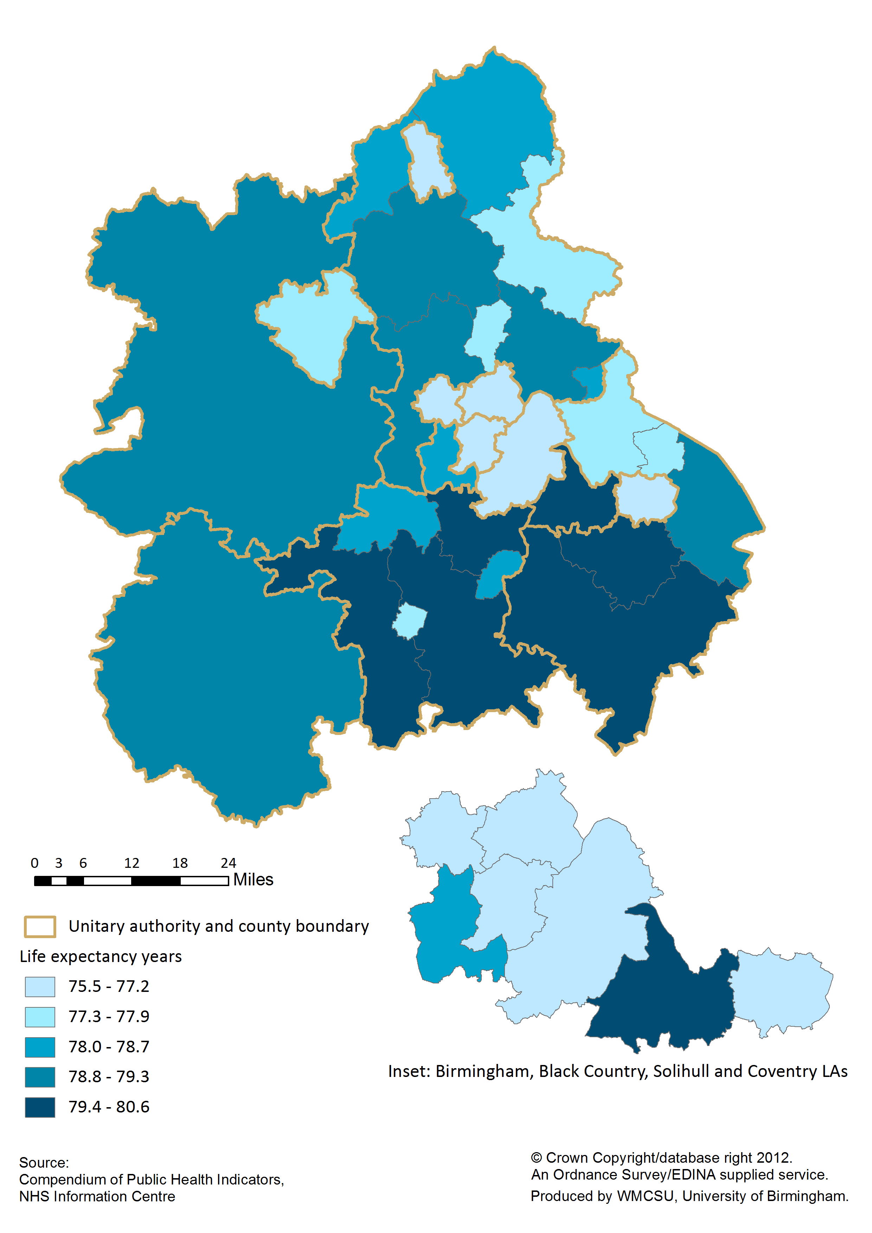
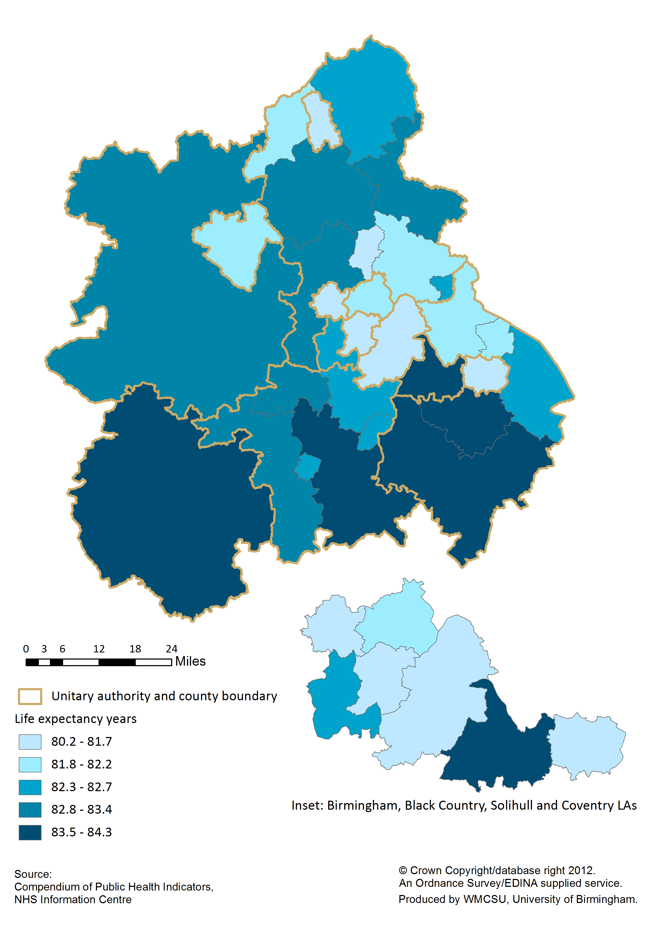
Life expectancy by local authority
Life expectancy at birth by local authority, West Midlands 2008-10
Males
Females
West Midlands Key Health Data 2011/12
Chapter 7 Measuring inequalities in small area life expectancy
Daniel Eayres, Jane Fletcher, WMCSU; Paul Kingswell, NHS Warks

Slide 7
Life expectancy by local authority
Male life expectancy at birth vs. Deprivation by local authority, West Midlands 2008-10
Chapter 7 Measuring inequalities in small area life expectancy
Source: Compendium of Population Health Indicators, NHS Information Centre;
Indices of Deprivation 2010, Department for Communities and Local Government.
West Midlands Key Health Data 2011/12
Chapter 7 Measuring inequalities in small area life expectancy
Daniel Eayres, Jane Fletcher, WMCSU; Paul Kingswell, NHS Warks

Slide 8
Small area geographies
Electoral Wards
  Politically relevant
  Frequent boundary changes
  Large variation in population size
Super Output Areas - Lower (LSOA) and Middle (MSOA)
  Not directly associated with admin/constiuency areas
  Stable boundaries
  Little variation in population size
West Midlands
  Wards n = 719, avg pop = 7,800 (LA avg 3,400 - 26,800)
  MSOAs n = 735, avg pop = 7,600 (LA avg 6,200 - 9,200)
  LSOAs n = 3,487, avg pop = 1,600 (LA avg 1,50-1,700)
Chapter 7 Measuring inequalities in small area life expectancy
West Midlands Key Health Data 2011/12
Chapter 7 Measuring inequalities in small area life expectancy
Daniel Eayres, Jane Fletcher, WMCSU; Paul Kingswell, NHS Warks

Slide 9
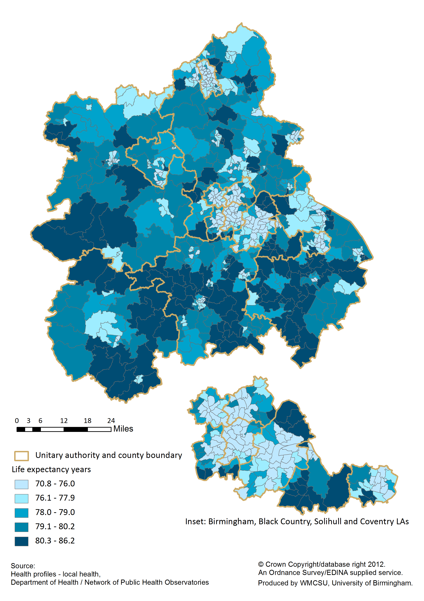

Life expectancy by small area geography
Life expectancy at birth by small area, West Midlands 2008-10
By ward
By MSOA
West Midlands Key Health Data 2011/12
Chapter 7 Measuring inequalities in small area life expectancy
Daniel Eayres, Jane Fletcher, WMCSU; Paul Kingswell, NHS Warks

Slide 10
Life expectancy by small area geography
Life expectancy at birth by small area, West Midlands Metropolitan County 2008-10
By ward
By MSOA
West Midlands Key Health Data 2011/12
Chapter 7 Measuring inequalities in small area life expectancy
Daniel Eayres, Jane Fletcher, WMCSU; Paul Kingswell, NHS Warks

Slide 11
Life expectancy by small area geography
Male life expectancy at birth vs. Deprivation by MSOA, West Midlands 2008-10
Chapter 7 Measuring inequalities in small area life expectancy
Source: Health profiles – local health, Network of Public Health Observatories;
Indices of Deprivation 2010, Department for Communities and Local Government.
West Midlands Key Health Data 2011/12
Chapter 7 Measuring inequalities in small area life expectancy
Daniel Eayres, Jane Fletcher, WMCSU; Paul Kingswell, NHS Warks

Slide 12
Slope Index of Inequality
Public Health Outcomes Framework life expectancy inequalities
Indicator 0.2i:
Slope index of inequality (SII) in life expectancy at birth based on national deprivation deciles of Lower Super Output Areas (LSOAs) within England [National level].
Indicator 0.2ii:
Number of upper tier local authorities for which the local SII in life expectancy (as defined in 0.2.iii) has decreased [National level].
Indicator 0.2iii:
SII in life expectancy at birth within each English upper tier local authority, based on local deprivation deciles of LSOAs [LA level].
West Midlands Key Health Data 2011/12
Chapter 7 Measuring inequalities in small area life expectancy
Daniel Eayres, Jane Fletcher, WMCSU; Paul Kingswell, NHS Warks

Slide 13
Slope Index of Inequality
Male life expectancy at birth by deprivation decile showing the SII, Warwickshire 2006-10
Chapter 7 Measuring inequalities in small area life expectancy
Source: Health Inequality Indicators, Network of Public Health Observatories.
West Midlands Key Health Data 2011/12
Chapter 7 Measuring inequalities in small area life expectancy
Daniel Eayres, Jane Fletcher, WMCSU; Paul Kingswell, NHS Warks

Slide 14
Slope Index of Inequality
SII for life expectancy at birth by upper-tier local authority and gender
West Midlands 2006-10
Chapter 7 Measuring inequalities in small area life expectancy
West Midlands Key Health Data 2011/12
Chapter 7 Measuring inequalities in small area life expectancy
Daniel Eayres, Jane Fletcher, WMCSU; Paul Kingswell, NHS Warks

Slide 15
Summary Points
LE is a high profile outcome indicator that needs to be monitored by HWBs, including the assessment of within local authority inequality.
Life expectancy in the West Midlands is continuing to improve but has remained persistently below the national average for both men and women.
The range between the highest and lowest local authority districts LEs in the West Midlands is ~5 years for males and ~4 years for females.
Significant variation in LE at the ward, MSOA and LSOA deprivation deciles levels using 5-years of mortality data.
At all area levels there is a strong association between LE and deprivation. The association is stronger and the relationship steeper for males than for females.
Wide inequalities in life expectancy exist within even those local authorities that have high life expectancies overall.
SII values for WM upper-tier LAs range from 4.8 to 11.7 years for males and 2.8 to 10.3 years for females.
Measuring the change in the SII over time in individual LAs will be problematic as the confidence intervals are wide and long time periods are needed.
Chapter 7 Measuring inequalities in small area life expectancy
West Midlands Key Health Data 2011/12
Chapter 7 Measuring inequalities in small area life expectancy
Daniel Eayres, Jane Fletcher, WMCSU; Paul Kingswell, NHS Warks

Slide 16
West Midlands Key Health Data 2011/12
END
Chapter 7 Measuring inequalities in small area life expectancy
Daniel Eayres, Jane Fletcher, WMCSU
Paul Kingswell, NHS Warwickshire

